Slide 1
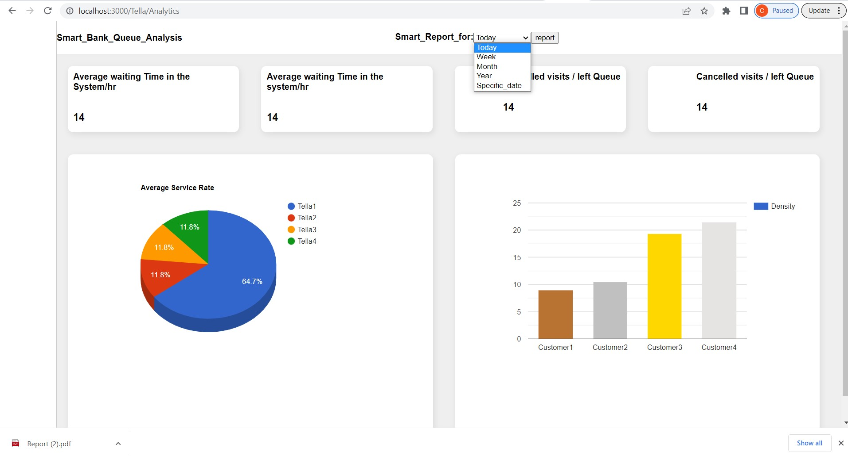
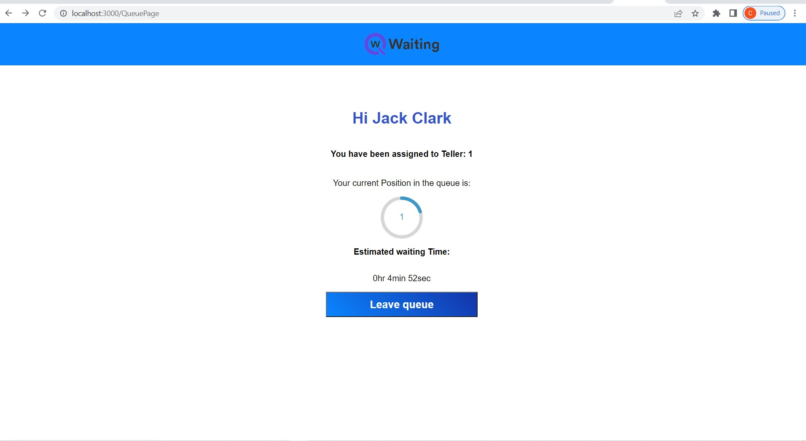
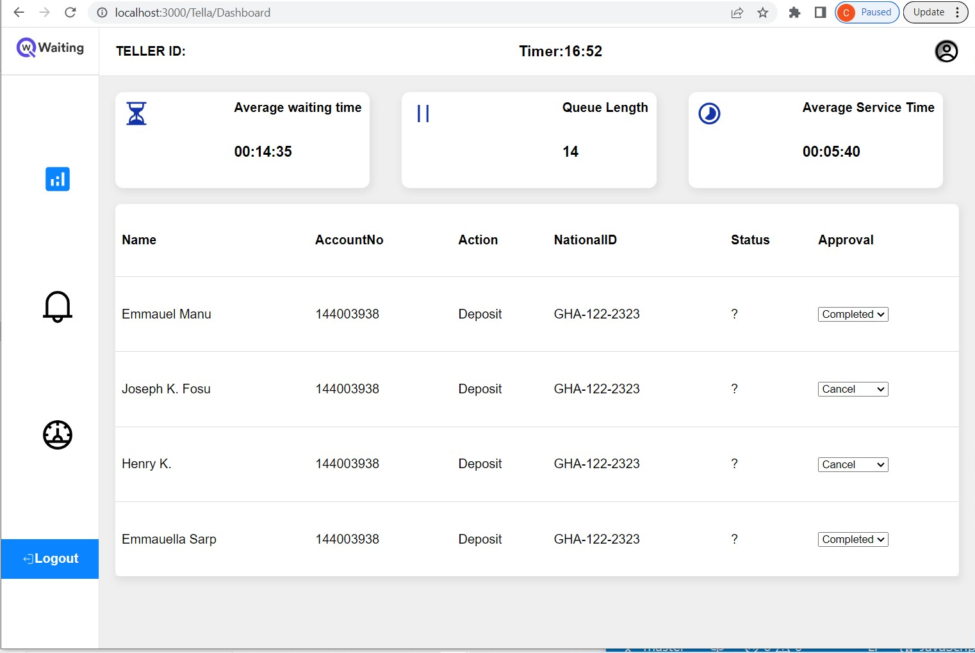
Kwame Nkrumah University of Science and Technology
College of Science, Faculty of Computer Science
SMART BANK QUEUE SYSTEM
Addotey Emmanuel Richmond and Duah Kwadwo Adjei
^{SUPERVISOR: Dr. Twum Frimpong}
^{Department of Computer Science}
ABSTRACT: With the increase in the demand for banking services, most banks in Ghana tend to find it difficult attending to the services of their numerous customers in an organized fashion at their banking premises .This mostly brings about congestion especially with the long queue formation causing some customers to wait outside the banking halls and others who anticipate a long period of waiting before their turns to vacate the banking premises. Services like customer enquiries can be automated as a way to reduce the traffic at the banking halls and also with the help of queuing models, systems can be developed to help customers join bank queues virtually and have a live update of their waiting time and also position in the queue in with the aid of devices such as mobile phones and laptops provided they have internet connection.
The main purpose of this project is to develop a web application system that makes use of a suitable queuing model and an AI model to streamline the banking services offered by the tellers(A.K.A front desk wokers) and also a chatbot to handle the frequent customer enquiries to reduce the number of people who visit the banking premise for their service, there is also a report generation feature and system analytics feature.
Introduction
Time is a crucial factor and hence customers expect a time efficient and smooth experience when using banking systems. However, many branches still rely on inefficient methods of managing customer queues such as manual calling and allowing customers to join physical queues to wait for their turn for service.
This is where smart bank queue management web application system comes into play which creates a virtual queue where customers can join with the aid of a mobile phone ,tablet or a personal computer connected to the internet
Objectives
Main objectives:
To develop a system to enable customers to virtually join a bank queue for the various services and to develop a chatbot to handle customer enquiries.
Specific objectives:
To build a database to manage the various data involved in the operations of the queuing system .
To build an automated chatbot to handle all the user enquiries to avoid users from visiting the bank for assistance that can easily be handled
To make use of Predictive AI model to help the system determine the best line of queue for incoming customers
References
1. Project Management Methodologies - Everything You Need To Know. (n.d.). Project Management Methodologies - Everything You Need to Know. Retrieved September 29, 2022, from https://www.teamwork.com/project-management-guide/project-management-methodologies/
2. Software Processes in Software Engineering - GeeksforGeeks. (2019, September 4). GeeksforGeeks. Retrieved September 29, 2022, from https://www.geeksforgeeks.org/software-processes-in-software-engineering/
3. Software Processes - javatpoint. (n.d.). www.javatpoint.com. Retrieved September 29, 2022, from https://www.javatpoint.com/software-processes
4. React (JavaScript library) - Wikipedia. (2013, May 29). React (JavaScript Library) - Wikipedia. Retrieved October 11, 2022, from https://en.wikipedia.org/wiki/React_(JavaScript_library)#cite_note-react-3
Development Tools
React Framework using JavaScript for development of the client application.
MySQL will be used to store and manage the database for the bank queuing.
Rust programming language for the Random Forest Prediction Model.
Actix Web Framework for the software’s backend
Problem Statement
Majority of banks in Ghana in the likes of Access Bank Ayeduase branch and fidelity bank knust branch experience inefficiencies in queue management mostly during peak periods resulting in congestion and frustration of customers especially when they have no precise estimate of how long they would have to wait for their turn to be served. Long wait times and confusion during peak hours have led to customers waiting outside the banking hall, causing disorganization and instances of line-cutting. Furthermore , some customers choose to leave and return later due to extended wait times, leading to missed revenue opportunities for the bank such as when the bank isn’t aware of the customers that leave the queue without being attended to.
The existing systems fails to meet the above stated problems and hence the need for this online queue management system to create a virtual queue to streamline operations and enhance the overall efficiency of the banking services.
Methodology
1.Conduct a comprehensive research on existing bank queuing systems including their strengths and weaknesses.
2.Find out how the various activities are carried out in the bank(Company A)
3.Define the data which the system will require such as User information, transaction data,queue status.
4.Develop a queuing model which would be used for effective management of the activities
5.Develop a webserver that communicates between the client ,the user and the bank staff through http REST APIs.
6.Implement multiserver queue model to suit the system of 4 Tellers.
7.Implement predictive Artificial Intelligence model with Random Forest Prediction Model in Rust programming language/Python...
8.Develop a chatBot using OpenAI API ro handle customer queries..
9.Develop a web client application for users both mobile and desktop to enable users interact with the system for the various activities .
10..Develop a database to handle the data involved in the activities of the bank queuing system.
Conclusions
The computer system’s ability to efficiently and accurately analyze and optimize the queueing process of various bank services has shown that it is immensely beneficial to both the customers and the staff. Its value cannot be underestimated, especially in enhancing customer satisfaction and loyalty not leaving out the smooth waiting experience they attain.
The smart bank queueing system makes the banking experience more convenient and enjoyable for the customers, as they can save time and effort by using the system’s features and not bother so much about their physical position being overridden by another because their position in the queue is visible to them and orderly arranged. This system also reduces stress and frustration for the staff, as they can manage their workload and resources more effectively. This system is a lot of fun to use, as it provides clear and user-friendly guidance and information.
Screenshots

